Slide 1
Quantum Computing Architectures (EE274) Lecture 16
Hiu-Yung Wong
Mar. 20, 2025
hiuyung.wong@sjsu.edu, Office: ENG363
http://www.sjsu.edu/people/hiuyung.wong/index.html

Slide 2
Outline
Silicon 2-qubit Gate
Lagrangian Mechanics and Hamiltonian Mechanics
Simple Harmonic Oscillator (SHO)
Quantization of SHO

Slide 3
Announcement
I have posted project part 1. Please check the due date and start working on it.

Slide 4
Spin Qubit Quantum Computer
Chapters 11 and 12 of “Quantum Computing Architecture and Hardware for Engineers: Step by Step”

Slide 5
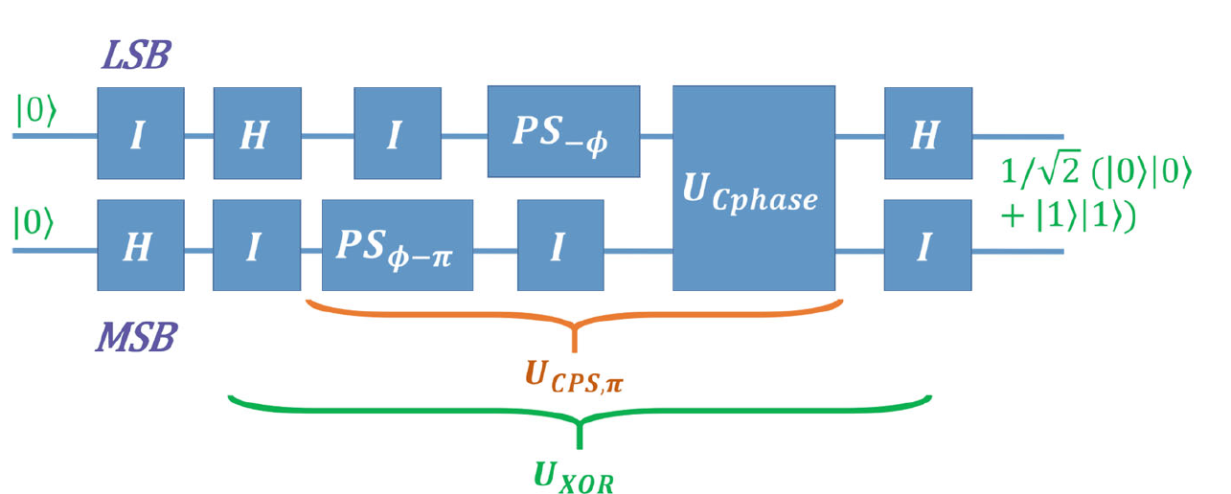
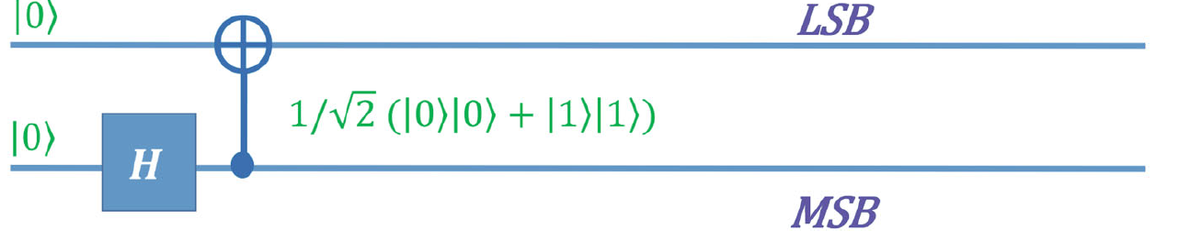
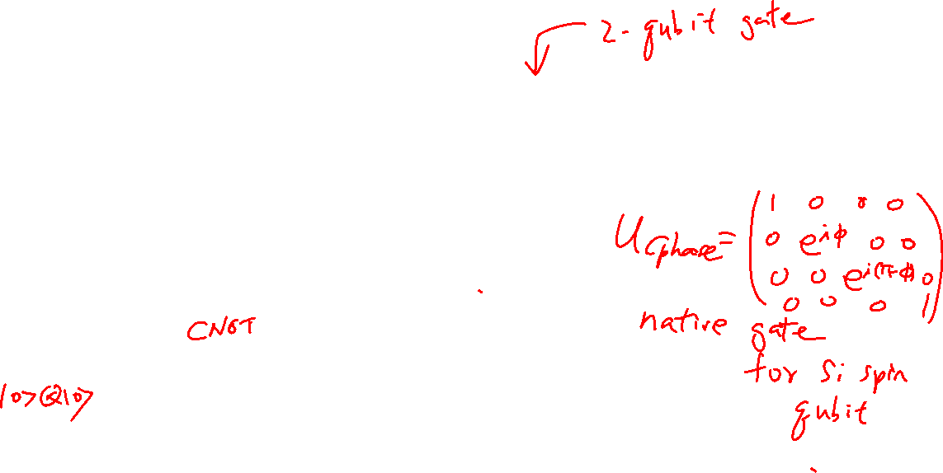
Implementing CNOT from a Native Gate

Slide 6
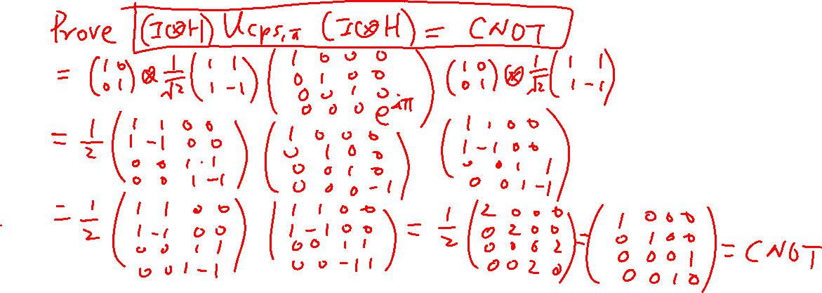
Two Qubit Gate – How to Form a CNOT Gate?

Slide 7
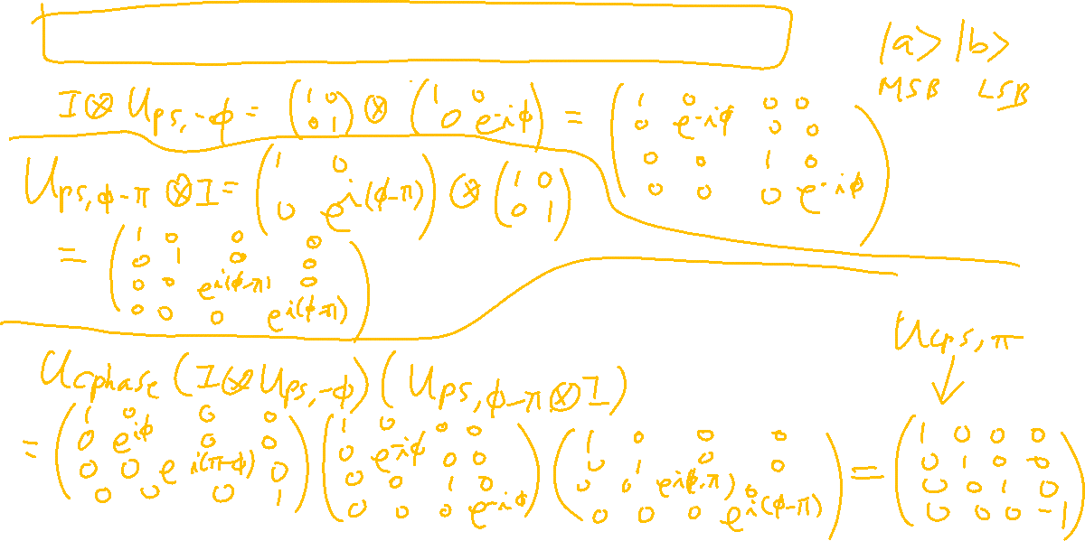
Two Qubit Gate – How to Form a CPS_{π}?

Slide 8
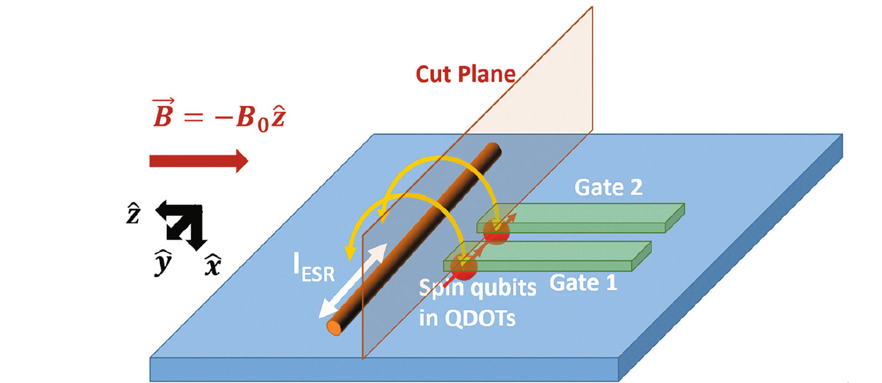
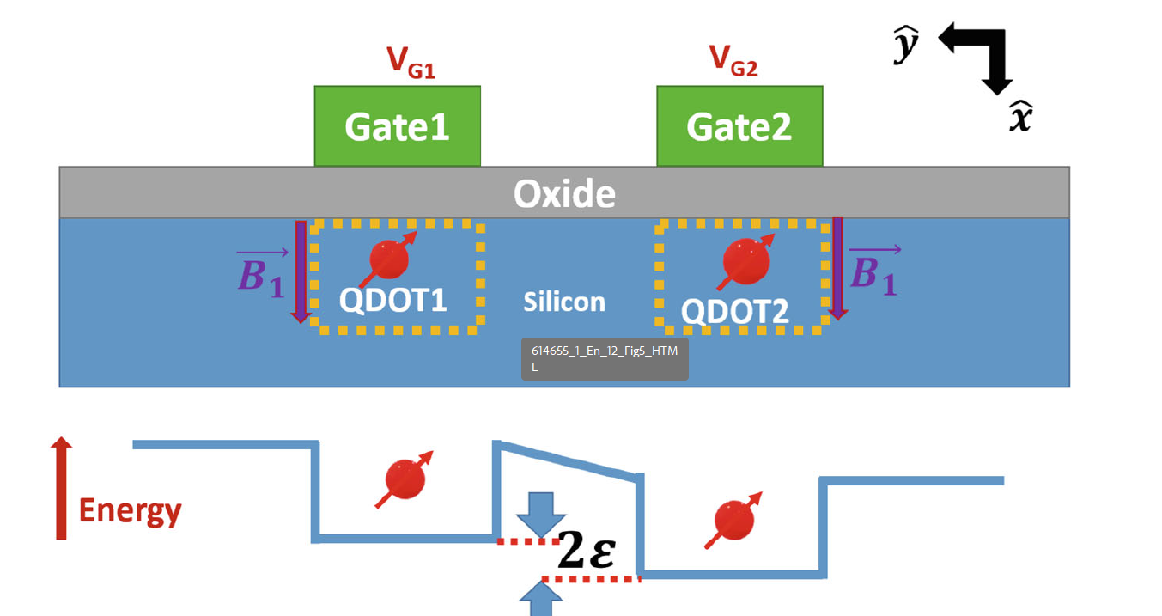
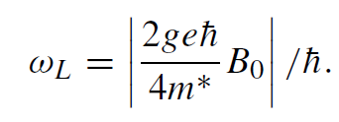
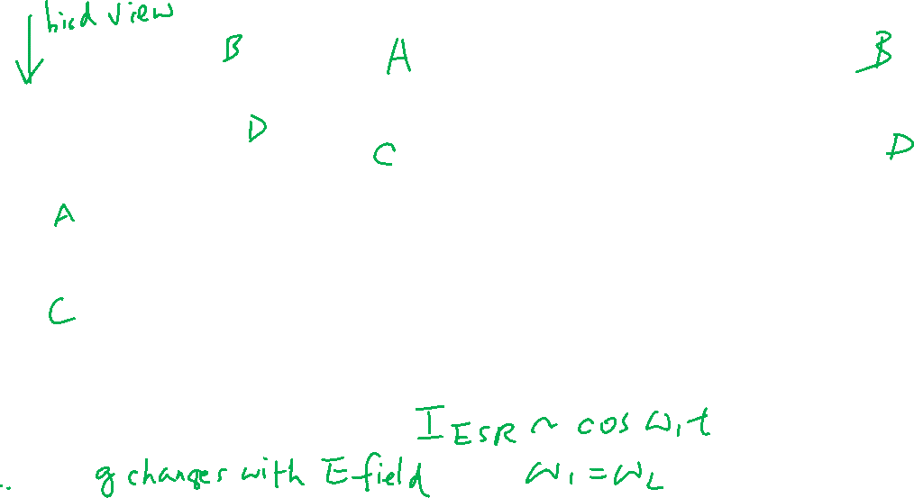
Implementation of a Cphase Gate
Achieve different Larmor frequencies in different qubits
Different B₀
Different g through Stark Effect

Slide 9
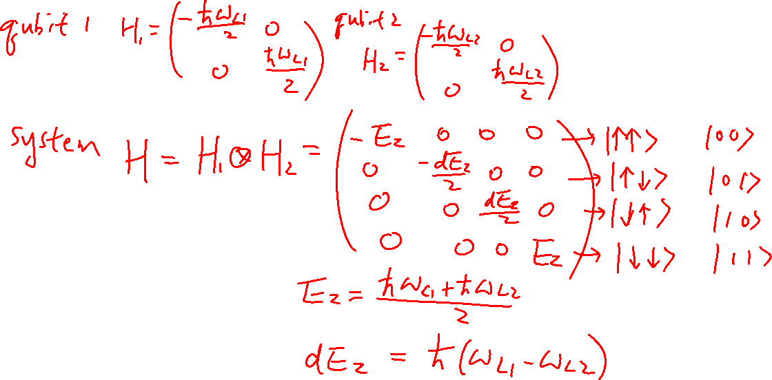
Implementation of a Cphase Gate

Slide 10
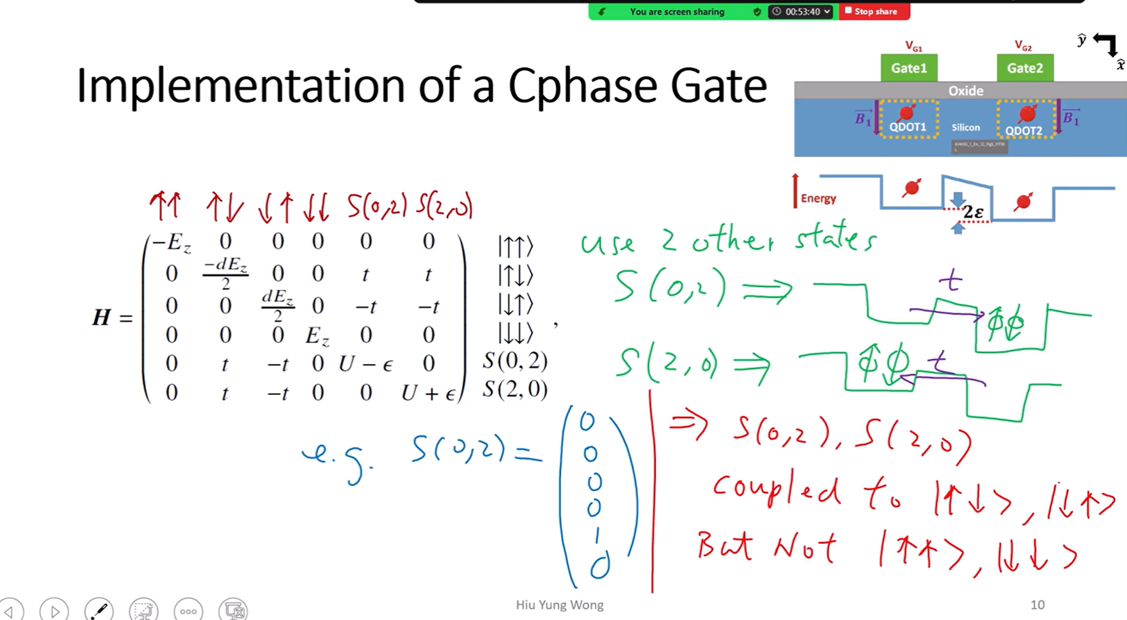

Slide 11
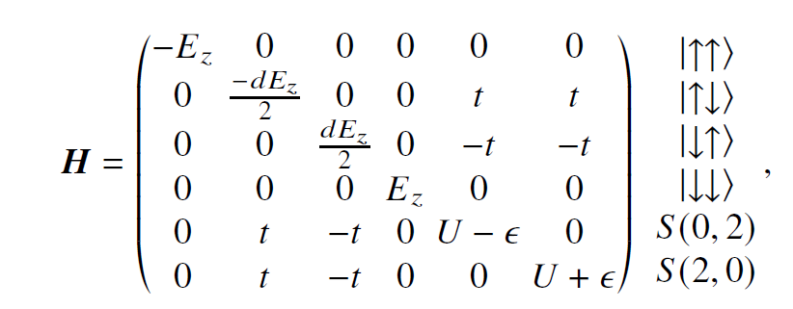
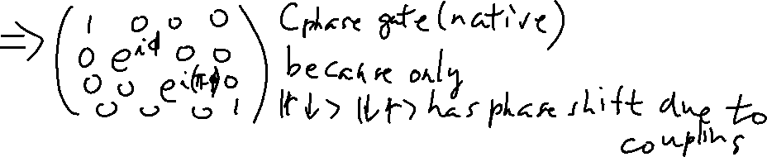
Implementation of a Cphase Gate

Slide 12
Lagrangian and Hamiltonian Mechanics
Chapters 13 of “Quantum Computing Architecture and Hardware for Engineers: Step by Step”

Slide 13
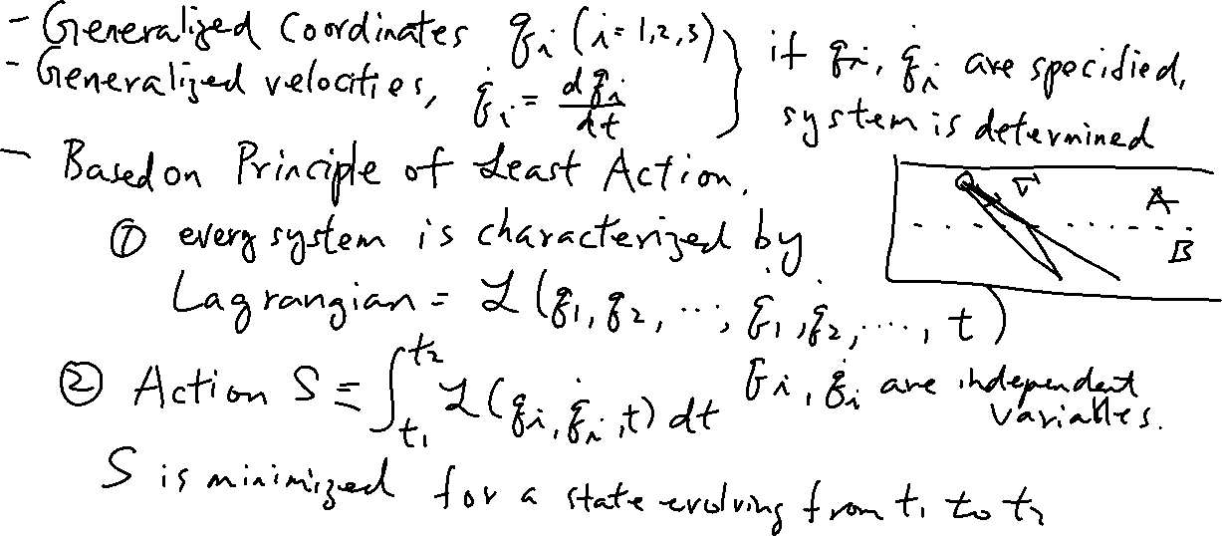
Lagrangian Mechanics
Learning outcomes: Understand the concept of generalized coordinate and velocity

Slide 14
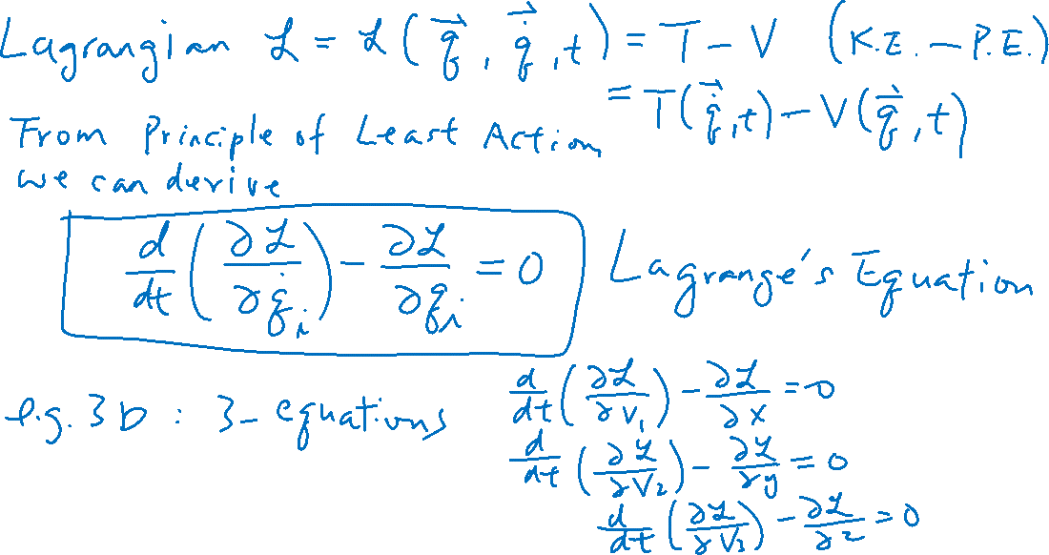
Lagrangian Mechanics
Learning outcomes: Lagrange’s Equations

